Slide 1

Data Science Agility
♥
a tale of three small and agile projects
Pierdomenico Fiadino, PhD
Big Data Analytics Unit at EURECAT

Slide 2

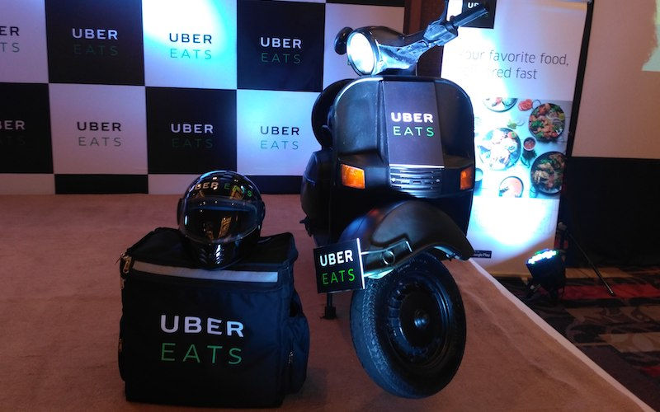
The Uber case
Quick facts
Founded in
2009
Operations in
>600 cities
Employees
>12000
Revenues (in 2016)
6.5 B$
Riders (in 2016)
Photo courtesy of Business of Apps
40 M
appetite comes eating…
UberEATS
Mobile meal ordering service
Launched in San Francisco (‘14)
>30 minutes delivery
5M downloads (Play Store)

Slide 3
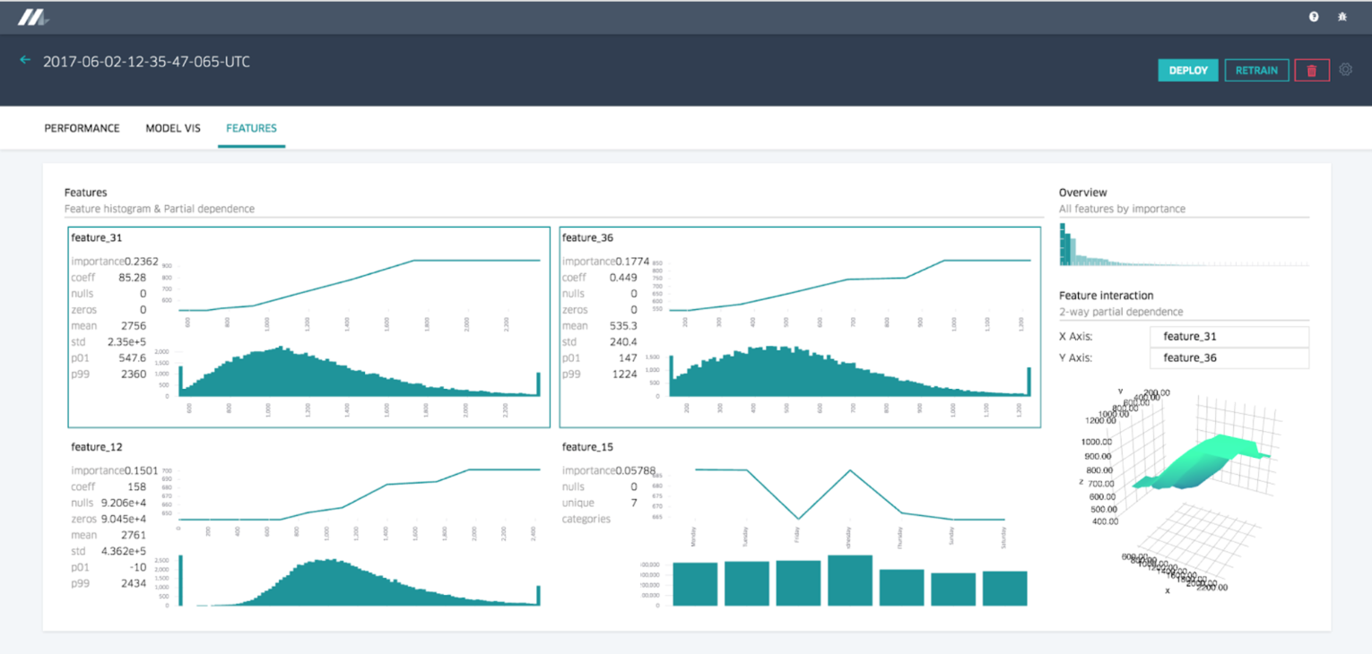
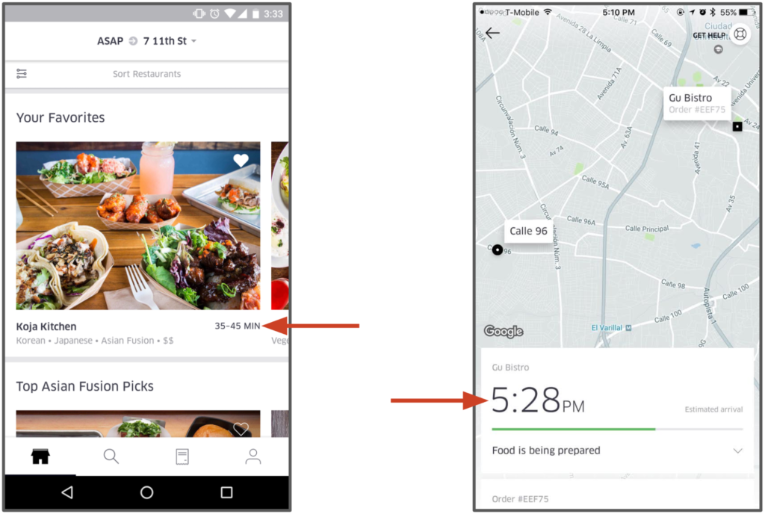
Uber: big A.I. investments
Michelangelo
Uber’s ML platform
State-of-the-art technologies
HDFS, Spark, TensorFlow, …
AI Labs (Seattle, 3000+ engineers)
Estimation of preparation time for UberEats
source: eng.uber.com/michelangelo

Slide 4

What about smaller/shorter projects?
say, 2-3 months, small team (1-5)
“Judge me by my size,
do you?”
- Master Yoda

Slide 5
First story: Alphanet
building BI-capable and extensible Big Data platforms
Quick and lean

Slide 6

Road cameras: security and traffic
About Alphanet
Catalan startup
Road monitoring & security
>200 monitored road segments
project goal: deploy a BI platforms to allow visualization of traffic statistics
monitored road sector
tens of cameras, tens of monitored sectors
Goal: MVP platform

Slide 7









Alphanet: data pipe-line
DATA SOURCE
Code versioning platform
Simple/inexpensive alternative to BDA platforms (e.g., Spark)
External data source for data enrichment
Spanish traffic authority
legacy RDBMS
historical data
near-real-time
rate GBs/months
plate numbers
DGT API
vehicles metadata
+ python API consumer
data enrichment
real-time applications and dashboards
CDC
data processing
data processing
enriched
data
+ GeoServer
flexible pipelining tool
supports ETL
Supports future extensions (additional real-time applications)
distributed search engine
supports analytics and visualization (Kibana)
near-real-time capabilities
log parsing tool
Change Data Capture (CDC)
in memory k-v store
1 node (cheap)
future real-time applications (e.g., notification system)

Slide 8





Alphanet: conclusions
Data aggregations, support for traffic analytics
Supports extensions
Dashboard
600€/month
Kibana-based
600€/month
Inexpensive cloud infrastructure
400€/month
MVP at the end of the project
250€/month
Project duration: 3 months
building infrastructure and algorithms

Slide 9
Second story: 012.cat
Citizen information office
Data characterization and informed actions

Slide 10


012: Citizen Information Service
Telephone Information Service for Citizens
Managed by Generalitat de Catalunya
Paid service (time-based billing)
Answers to questions of different topics
health, tax-related, wellness, welfare, traffic, ...
Project goal: study call routing process
012
virtual
agent
domain
expert
call evaluation
domain
expert
domain
expert
general
purpose
agent

Slide 11
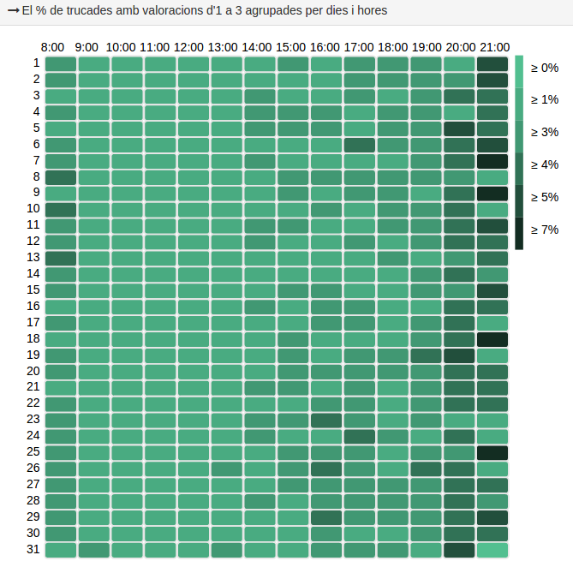
012: dive into historical data
dataset
Call time
(time of the day, day of the week, etc.)
time span
Call length
(waiting/talking time, etc.)
1 year
number of records
800K
User info (when available)
(geographic position, .)
attributes
Other call metadata
(topics, routing, agents, ratings, etc.)
size
>10GB
statistical characteristics
how ratings are distributed
what are the factors that
influence the rating the most?
what is the average talk time?
when bad ratings are
more likely to happen?

Slide 12
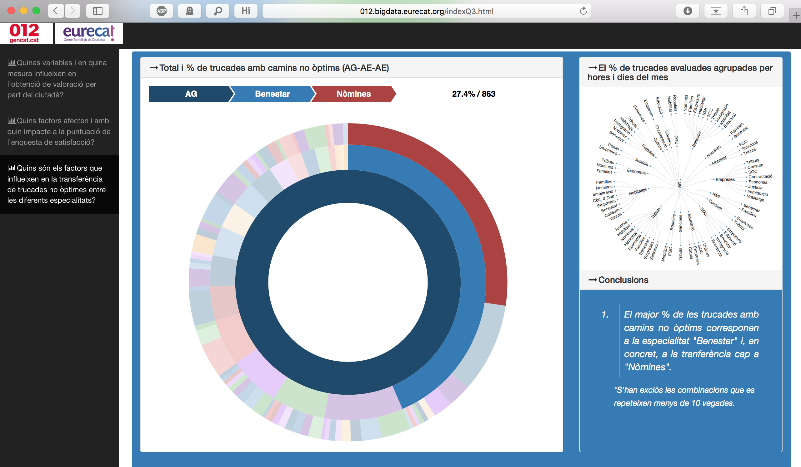
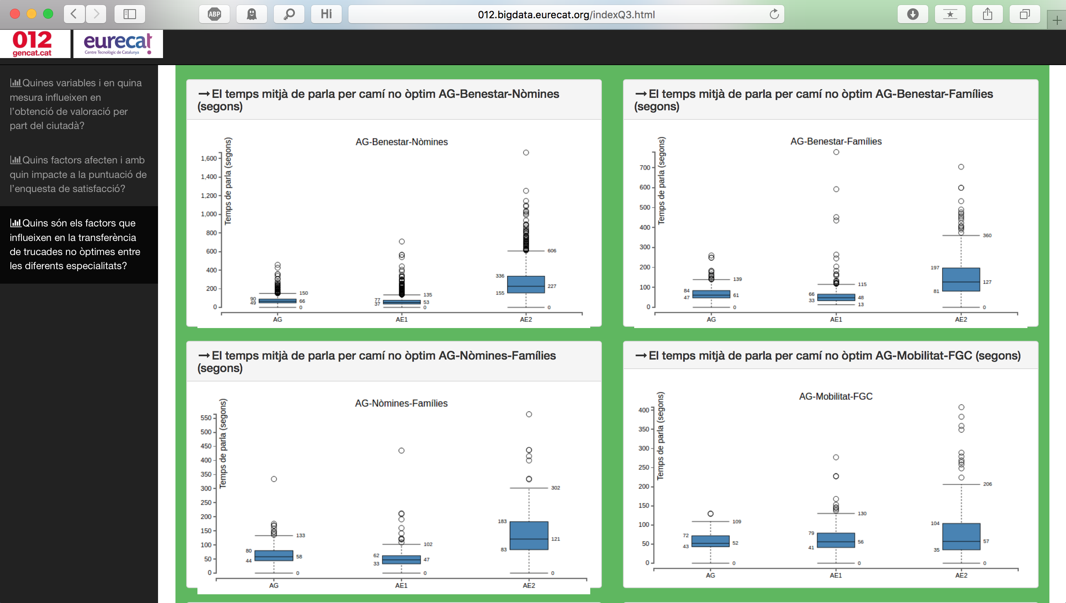
012: Kibana dashboards
explore sub-optimal paths and their frequency
e.g., which topics are most likely involved
study statistics of
sub-optimal paths
e.g., time spent in the routing process

Slide 13
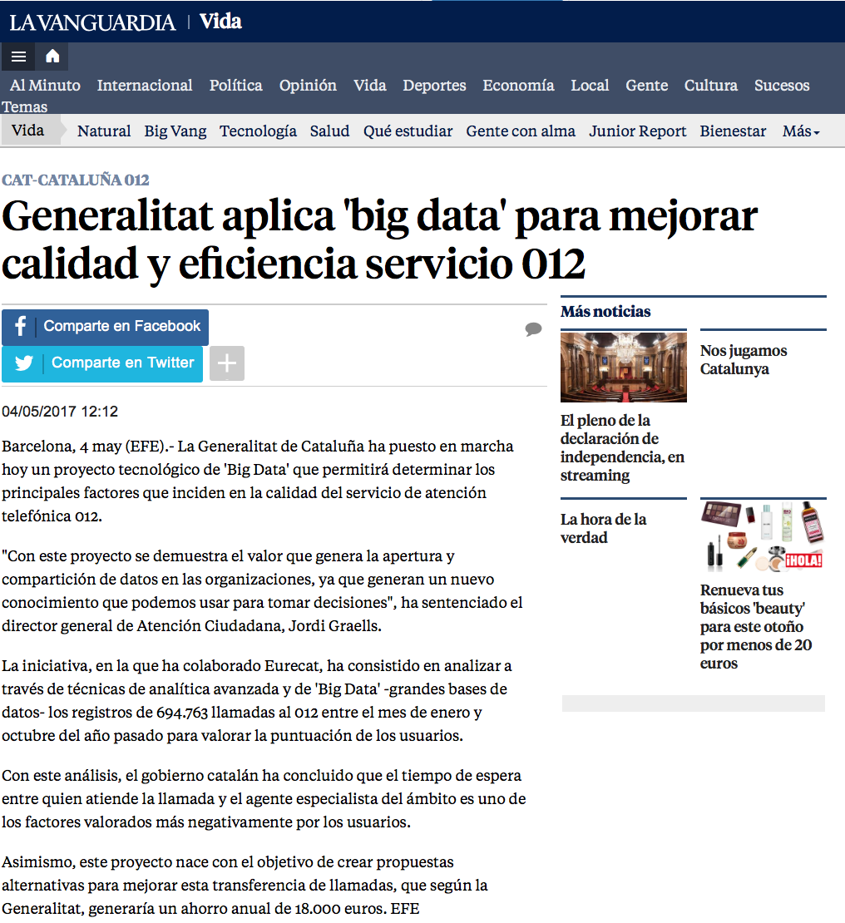
012: conclusions
Exploratory analysis
Statistical characterization of dataset
Dashboard
Inspect call stats, common routes, etc.
Outcome and informed actions
Internal optimizations cut the costs (18k€/year)
Project duration: 3 months
from handover of dataset to final reporting

Slide 14
Third story: Glovo
”Anything you want, delivered in (LESS!) minutes”
Optimize existing algorithms and test them in production

Slide 15


Glovo
“Anything you want, delivered in minutes”
One of the coolest startup in town
Last-mile delivery (meals, groceries, etc.)
Shipment time <30minutes
Partnership with other businesses
Fast growing platform (>250K users)
Been in the game for a couple of years
Rather large dataset (live + historical)
Existing back-end
Time to take advantage of data…

Slide 16


Glovo: optimizing notification algorithm
courier selection algorithm
distance-based
order notification
algorithm
distance-based (fixed)
courier waits till the meal is ready
notification
time
restaurant
destination
courier
project goal(s)
new order notification algorithm based on estimated preparation time
idea
caveats
The notification should occur at the right moment
notify
too early
Courier arrives late
(cold) pizza waiting
The right moment depends on the meal preparation time
notify
too late
Courier arrives early
higher waiting time

Slide 17
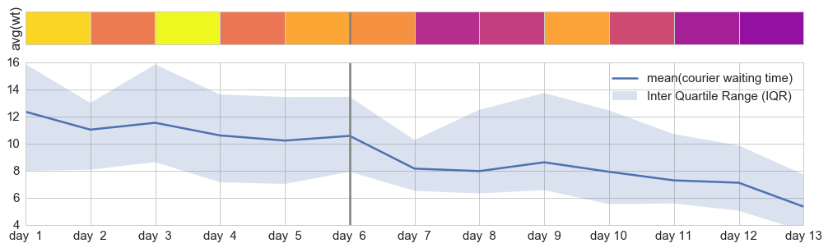
Glovo: optimizing notification algorithm
time of the day
restaurant type
weather and traffic
estimation of
preparation time
Preparation time triggered notification
Statistics of historical data + external factors
Restaurant-based estimation of preparation time
Calculate travel time to restaurant
Notify restaurant at just the right time
Minimize glover’s waiting time
Reduce overall delivery time
avg. waiting (wasted) time per order
activation of new algorithm
average waiting time (wasted) trend
average waiting time trend
average waiting time trend
average waiting time trend
average waiting time trend

Slide 18
Glovo: conclusions
Exploratory analysis
Characterization of historical data
New notification algorithm
Statistical based
Courier waiting time decreased by ~40%
Major overall improvements
Project duration: 3 months
From exploratory analysis to deployment of new algorithm in production and tests

Slide 19

Small-term, agile projects
How-to make them work
Clear/delimited goal (and be ready to modify it on the go)
“Size matters not”
Communication is the key (product owner always in the loop)
Fast prototyping process required
The right tools: many out-the-shelf solutions would do
- Master Yoda
The right team: senior profiles & cross functionality for the win

Slide 20
THANK YOU
Pierdomenico Fiadino, PhD
pierdomenico.fiadino@eurecat.org
http://fiadino.org

